Slide 1
Finished models: what we ran and what it shows
47
GDT-objective arm-seeds, weights saved
0 of 6
Training, GDT scoring and explainability, as of 6 November 2026
sequence arms pass the pinned GDT bar
Builds on the CS2 win-probability short deck (XGBoost explainability). Validation results unless marked.
+0.0011
log-loss gain of the GRU at 25k steps, 5 of 5 seeds
Notes:
Covers the last two days: sequence-model training on the GDT objective and on log loss, the regularisation test, the XGBoost comparison, explainability of the XGBoost model, and the status of weights and data.

Slide 2
No arm passes the GDT bar; 25k steps help the GRU
0 of 6
+0.0011
0.45025
sequence arms pass the GDT bar against the GRU control
log-loss gain of the GRU when it stops at 25k steps (5 of 5 seeds)
XGBoost 83-input validation log loss, in the same range as the GRU
Weights. The 47 GDT-objective arm-seeds have weights saved in S3 and locally. The log-loss runs saved none, so their weights cannot be exported without retraining.
Explainability. Done for the XGBoost model in the explainability report: SHAP, group ablation, calibration. As far as the records show, attribution has not been run for the sequence models.
Holdout. Read once, for XGBoost. No candidate passes the pinned rules, and no choice used the holdout.
Sources: REPORT_2026-11-06 sections 1, 3.2 to 3.6; regularisation result a3ceeda7 (Meridian); pins 0d97f8f6, 56316f69.
Notes:
The 0 of 6 is the pinned GDT bar: the whole 95% interval above zero and a positive situation-weighted estimate. MinGRU and xLSTM sigmoid-gate have positive point estimates, but their intervals include zero. The +0.0011 is the log-loss GRU at 25k steps against the 30k reference, a stopping-point effect on the GRU only.

Slide 3
Two days of runs: what was done
47
5
10
43 of 47
GDT-objective arm-seeds, each retrained once with weights saved
seeds for the round-2 arms, one for the rest; each paired with the GRU on the same seed
regularisation runs: A (30k, dropout 0.2, weight decay 1e-4); B (25k, none)
retrained runs match their original validation loss within 0.0001
GDT scoring: a verbatim copy of the intern's grader (score_gdt.py), not re-derived.
Reproduction: the four TCN seeds differ from their originals by up to 0.0006, likely GPU nondeterminism (not yet confirmed).
Deviation: the capacity transformer ran without the 500-step warm-up its pin specified.
Compute: RunPod RTX 4090 pods on network volume z7yvc40ykx. All pods are closed.
Sources: REPORT_2026-11-06 sections 4 and 5; weights manifest (47 rows); regularisation metrics per seed on the network volume (results/reg_A, reg_B).
Notes:
All pods are closed (REPORT section 5). The GDT scoring is a verbatim copy of the intern's grader, so it is not a re-implementation. The capacity transformer ran without the 500-step warm-up its pin specified; the result is reported as run.

Slide 4
On log loss, the five-seed arms span about 0.001
Arm | Log loss, log-loss objective | Log loss, GDT objective | Note
xLSTM 7B-style block | 0.449940 | 0.450746 | best on log loss
xLSTM closed-form | 0.450123 | 0.450441
MinGRU | 0.450138 | 0.450274 | best on GDT objective
RWKV-7 | 0.450168 | 0.450730
xLSTM sigmoid-gate | 0.450337 | 0.450474
TCN | 0.450735 | 0.450480
GRU control | 0.451061 | 0.450392 | reference
On log loss the GRU control is the worst of the seven five-seed arms. On GDT-trained log loss it is second of seven. Gaps below about 0.0005 are within seed noise.
Validation, final-step, 1,515,228 seconds, 1,168 matches. Five seeds per arm. Source: REPORT_2026-11-06 sections 3.1 and 3.2.
Notes:
Five seeds each, final-step scoring on validation. Seed-to-seed spread is about 0.0005, so gaps smaller than that are within noise. The GRU control is the reference in both objectives.

Slide 5
On GDT, no sequence arm passes the bar
Arm (vs GRU, same seed) | GDT difference | 95% interval | Situation-weighted | Bar met
MinGRU | +0.00039 | -0.00014 to +0.00093 | +0.00012 | no
xLSTM sigmoid-gate | +0.00019 | -0.00054 to +0.00091 | +0.00024 | no
xLSTM closed-form | -0.00006 | -0.00070 to +0.00067 | +0.00023 | no
TCN | -0.00000 | -0.00062 to +0.00068 | -0.00045 | no
RWKV-7 | -0.00059 | -0.00138 to +0.00027 | +0.00013 | no
xLSTM 7B-style block | -0.00094 | -0.00184 to +0.00002 | -0.00075 | no
Correction to an earlier pick. Pin c807884d chose xLSTM sigmoid-gate (+0.00131) by scoring the log-loss-trained models on GDT. The GDT-trained models give +0.00019, so that candidate is unconfirmed.
GDT on the validation proxy population (297 matches, per the 6 Nov report). Pooled over five seeds; match-cluster bootstrap, 1,000 resamples.
Notes:
The bar needs the whole 95% interval above zero and a positive situation-weighted estimate. None of the six arms clears it. The earlier pick of xLSTM sigmoid-gate came from scoring the log-loss-trained models on GDT; the GDT-trained models, scored the same way, do not reproduce it (+0.00019).

Slide 6
Stopping at 25k steps helps the GRU on 5 of 5 seeds
Gain over the 30k GRU, by seed (thousandths of log loss; positive = better)
+0.00107
+2
+1.68
+1.81
mean gain of the GRU at 25k steps over its 30k reference: 0.449989 against 0.451061
+1
+0.94
+0.93
+0.48
+0.46
+0.19
-0.0002
0
-0.31
dropout 0.2 and weight decay 1e-4 at 30k: 0.451266, 2 of 5 seeds better
-0.61
-1
-1.22
Seed 0
Seed 1
Seed 2
Seed 3
Seed 4
GRU only. The other arms were scored at 30k steps, so this does not rank architectures.
Dropout 0.2 + weight decay, 30k
No regularisation, 25k
Validation, log-loss objective, final-step. Arm settings from per-seed metrics on the network volume (reg_A: 30000 steps, dropout 0.2, weight decay 1e-4; reg_B: 25000 steps, none).
Notes:
The reference is the GRU at 30k steps on the log-loss objective (metrics record steps = 30000; the script default is 12,000). It reproduces the pinned 0.451061. Arm A (dropout 0.2, weight decay 1e-4, 30k) is not a lever: mean 0.451266, 2 of 5 seeds better. Arm B (no regularisation, stopped at 25k) has mean 0.449989. The gain is a stopping-point effect on the GRU only; the other arms were scored at 30k steps, so this does not rank architectures.

Slide 7
XGBoost is in the same range on validation
0.45025
0.45106
0.44999
XGBoost 83-input, validation log loss, mean of 3 seeds
GRU at 30k steps, validation log loss, mean of 5 seeds
GRU at 25k steps, validation log loss, mean of 5 seeds
GDT, seed 0. XGBoost against the GRU: -0.00071, 95% interval -0.00269 to +0.00131. Not distinguishable.
Holdout, one pinned read. Log loss 0.452295 on Oct 26 to 31, 3,315 matches, interval 0.449288 to 0.454983. Not used for any choice.
57-input XGBoost. The GRU beat it on validation on every seed (pin 921fa3dd). The 83-input model is the one the explainability report covers.
Sources: REPORT_2026-11-06 sections 3.5 to 3.7; pins 1b7c86fd, 56316f69, 921fa3dd.
Notes:
XGBoost 83-input: three seeds, mean 0.450252. The GDT difference against the GRU is measured on seed 0 only. The holdout number is the single pinned read (Oct 26 to 31, 3,315 matches). It is not comparable to the validation figures and was not used for any choice. The 83-input model file is models/winprob_xgb83_final.json in the repo, a CPU refit of the validated GPU model.

Slide 8
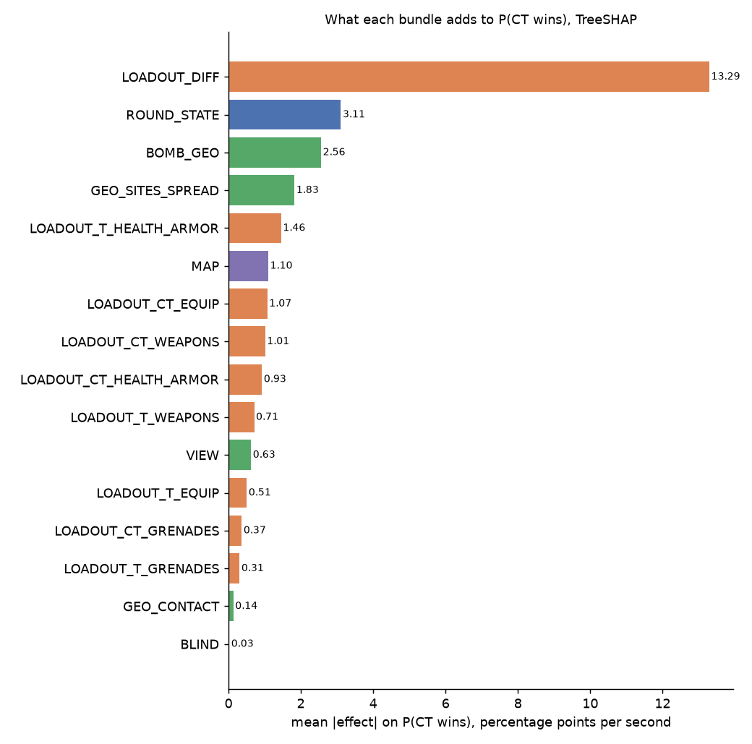
Loadout carries most of the XGBoost model's signal
13.3
points per second from the loadout difference, CT minus T
3.1
points per second from round state: alive counts, bomb, clock
3.5
points in total from the 24 position inputs
Mean absolute TreeSHAP effect, validation sample. Source: XGB explainability report, Table 2 (short deck slide 2).
Notes:
Mean absolute TreeSHAP effect on P(CT wins), validation sample, from the explainability report. The position total is across 24 inputs, not one. These are attributions for the XGBoost model only.

Slide 9
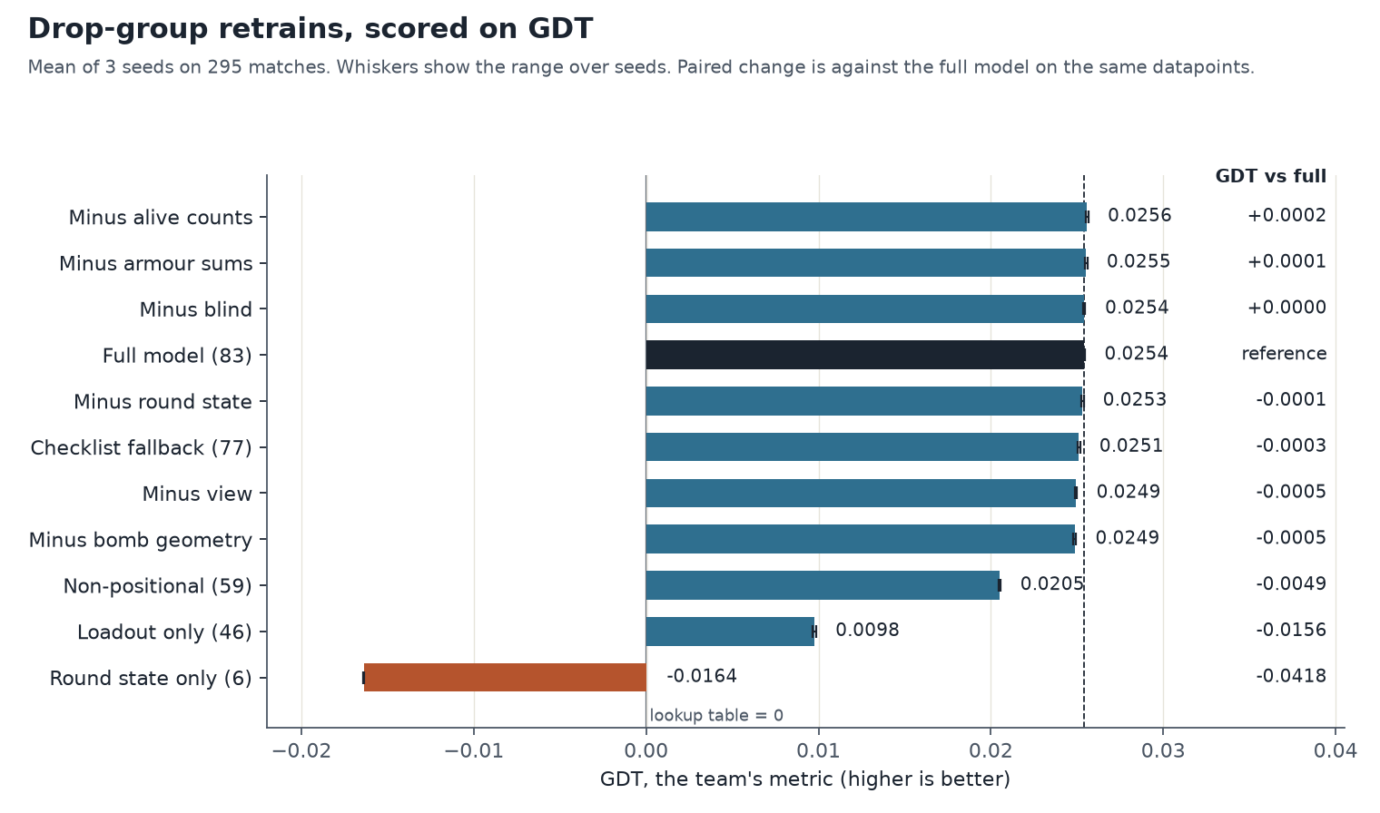
Loadout alone gives about 40% of the full model's GDT
Full model: 0.0254 GDT.
Loadout alone: 0.0098.
Round state alone: below the lookup table.
GDT on 295 matches, mean of three seeds (explainability deck). The report uses 297; to reconcile. Source: XGB explainability report, short deck slide 3.
Notes:
GDT is the gain over the lookup table. The full model scores 0.0254. Loadout alone scores 0.0098, which is about 39% of the full model. Round state alone scores below the table. The population here (295 matches) differs from the 297 in the 6 November report; to reconcile.

Slide 10
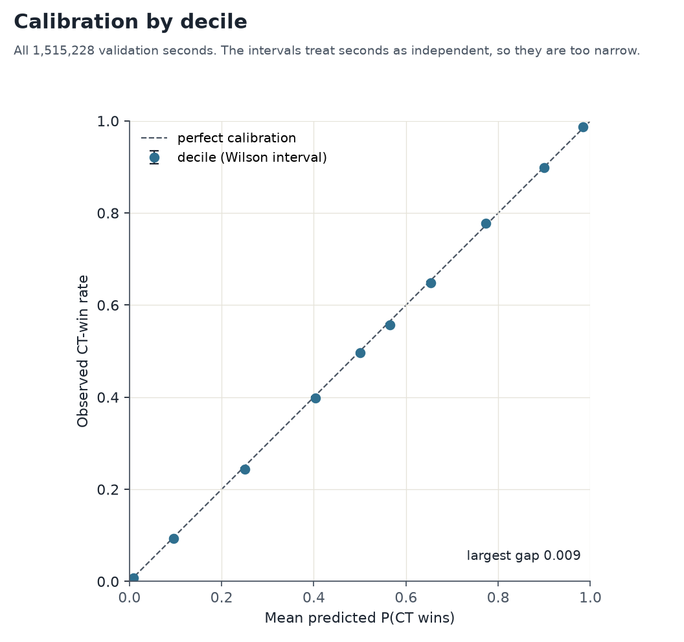
XGBoost is well calibrated by decile on validation
0.009
largest gap between predicted and observed CT-win rate, in any decile
The round-level check in 1-versus-5 states is not shown here: its unit and sample need confirming against the explainability report first.
83-input XGBoost booster on all 1,515,228 validation seconds. Source: XGB explainability report (short deck slide 7).
Notes:
Calibration is checked per second, in deciles. The round-level check in 1-versus-5 states (1.48 against 1, over 1,033 rounds) is in the explainability report, but its unit and sample are not confirmed in the records, so it is left off this slide until they are. Wilson intervals treat seconds as independent, so they are too narrow.

Slide 11
No arm fails to beat the table in any segment
Beats the table everywhere
Spread between GDT arms
Not done yet
All 19 arm variants beat the lookup table in all 12 segments with at least 20,000 seconds.
Five-seed GDT arms against the GRU: median spread 0.0011 across segments, widest 0.0016 (planted = 1).
Attribution for the sequence models. This analysis covers scenario-level gains only.
Log-loss-trained five-seed means beat the GRU by up to 0.0011 (xLSTM 7B-style block). Source: REPORT section 3.1.
Source: seg_check.py on the GDT-trained proxy rows (297 matches, validation only); segments with at least 20,000 seconds.
Notes:
Computed by seg_check.py on the GDT-trained proxy rows (297 matches, validation only). Segments are planted state, time-in-round thirds, alive counts and economy levels; only segments with at least 20,000 seconds are counted (12 in total). The spread is the range across the five-seed GDT arms of (GRU loss minus arm loss) in one segment. Attribution for the sequence models is not covered.

Slide 12
Weights, data and PII status
Item | Where | Status
GDT-objective weights, 47 arm-seeds | GitHub repo models/seq_gdt_weights; S3 results; handover bucket | saved; sha256 matches across copies
Log-loss weights | none | not saved; retraining needed to export
Regularisation runs, A and B | repo sequence/analysis/reg_results; S3 results | metrics only; no weights
TCN extra seeds (0, 1, 3, 4) | repo models/seq_gdt_weights/weights_tcnr* | 4 weight files with metrics
XGBoost 83-input model | repo models/winprob_xgb83_final.json | CPU refit of the validated GPU model
Dataset personal data | processed tables (1,353 files screened) | no direct identifiers found; pseudonymous, not proven clean
Data backup | local backup folder, with a copy of the RunPod volume | verified; raw E: data (989 GB) not backed up
Sources: weights inventory, repo and S3 listings, PII audit and backup verification (6 Nov 2026); weights_manifest.csv (sha256, 47 rows).
Notes:
Weights status is from the inventory of S3, the repo and local copies on 6 Nov 2026. The personal-data audit screened 1,353 processed parquet files; frozen-test, holdout and 26-31 Oct rows were left out. An automated scan is not proof of absence, so the slide does not describe the dataset as cleared. The RunPod volume copy holds all 76,188 objects (37.4 GiB) except 1,485 Python-environment files whose names Windows cannot hold; the environments rebuild from pixi.lock.

Slide 13
Decisions and next steps
1. Re-run the five-seed arms at 25k steps (proposed). Tests whether the step count changes the ranking. Needs a new pin first.
2. Holdout. No candidate passes the pinned rules. Decide: keep the holdout on hold, or pre-register a different rule before any read.
3. Served model. v6 (57 inputs) is served: the 20 October pin aaecad58 and the serving default agree, and the v7 and v8 metadata now say not served. The 83-input model scores better (validation 0.4503 against 0.4536) but the serving function cannot run it and no pin names it.
4. Population. The explainability deck gives 295 matches for its GDT figures; the 6 November report gives 297. Reconcile before presenting.
5. Volumes. The RunPod volume is copied to the local backup. Delete it only after an explicit confirmation.
Open items for 7 November 2026. GDT is the agreed objective.
Notes:
The 25k re-run is a proposal, not a decision, and needs a new pin before any run. GDT is the agreed objective. The served model is v6 per the 20 Oct pin.

Slide 14
Appendix: pins behind the decisions
64b9d52d validation only for every choice
064d46c76 GDT objective (PROVENANCE writes it as 64d46c76)
079f7189 amendment on the GDT objective
c807884d earlier xLSTM sigmoid pick on log-loss models (did not reproduce on GDT)
0d97f8f6 holdout candidate, on hold
31f6825b round-2 log-loss rule
1b7c86fd XGBoost 83-input, three-seed validation
56316f69 XGBoost holdout read (single)
921fa3dd GRU beats the 57-input XGBoost on every seed
c1f31a9d regularisation test: decision rule
a3ceeda7 regularisation test: result (created 6 Nov 2026 in Meridian)
Not recorded: result pins for the GDT-trained runs and for the round-2 log-loss test (PROVENANCE). c1f31a9d is recorded in the working notes and not yet re-checked in Meridian.
Notes:
Pins as cited in the 6 Nov report. a3ceeda7 was created today in Meridian for the regularisation result. c1f31a9d is recorded in the working notes and has not been re-checked in Meridian. Result pins for the GDT-trained runs and for the round-2 log-loss test are not recorded.

